Slide 1


#2 Regression & Model Validation
by Saturdays.AI
Saturdays.AI Madrid
Machine Learning

Slide 2

Week 2
Schedule
State of the course
Session 2 Review
Challenge
Notebook + resources

Slide 3
Sesión 2
Agenda
1:30 - Lesson #1 + Work!
3:30 - Coffee Break ☕️
03: 45 - Keep Working! 🚀
05:00 - Talk! 🗣

Slide 4
State of the course
#1 Exploratory Data Analysis & Classification ✅
#2 Regression & Model Validation 🔴 Today!
#3 Random Forest Deep Dive 🔜
#4 Unsupervised Learning 🔜
#5 Neural Networks, Gradient Descent 🔜
#6 NLP 🔜

Slide 5
Regression & Model Validation
Overfitting/Underfitting
Bias/Variance
Cross-validation
Regularization
Model evaluation
Linear Models

Slide 6
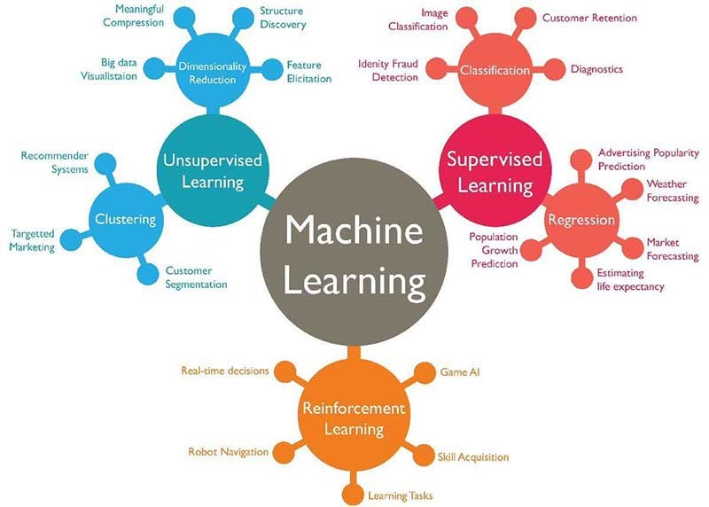
Machine learning
Categorical response variable
Classification problems
Linear response variables
Linear problems
Supervised Learning
Notes:
Jan

Slide 7

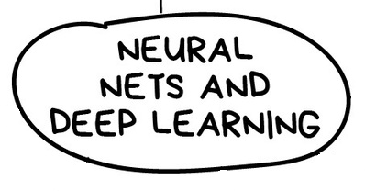
ML Algorithms

Slide 8

Supervised learning: linear problem (Ejemplo)
HOUSE PRICE Dataset
Id | SalePrice | MSZoning | YearBuilt | LotArea | Street
1 | 208500 | RL | 2003 | 8450 | Pave
2 | 181500 | RL | 1976 | 9600 | Pave
3 | 223500 | RL | 2001 | 11250 | Pave
4 | 140000 | RL | 1915 | 9550 | Pave
5 | 250000 | RL | 2000 | 14260 | Pave
6 | 143000 | RL | 1993 | 14115 | Pave
7 | 307000 | RL | 2004 | 10084 | Pave
8 | 200000 | RL | 1973 | 10382 | Pave
9 | 129900 | RM | 1931 | 6120 | Pave
Notes:
Jan

Slide 9
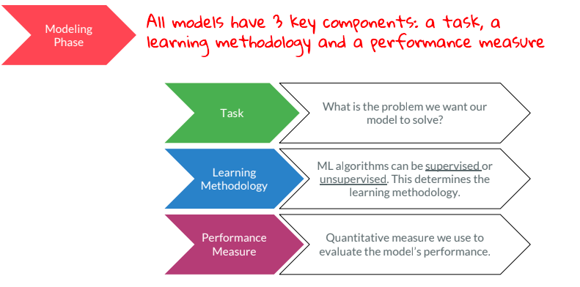
Regression & Model Validation

Slide 10
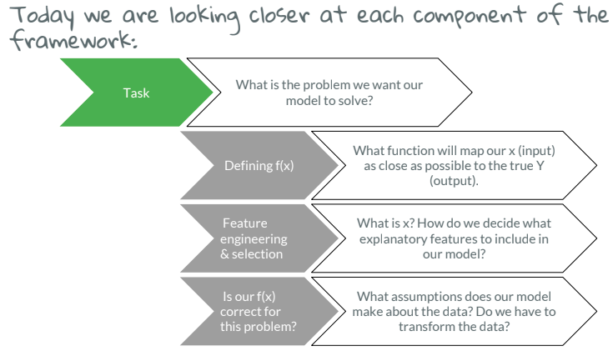
Regression & Model Validation

Slide 11
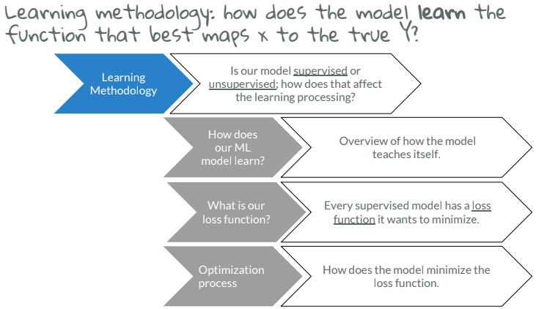
Regression & Model Validation

Slide 12
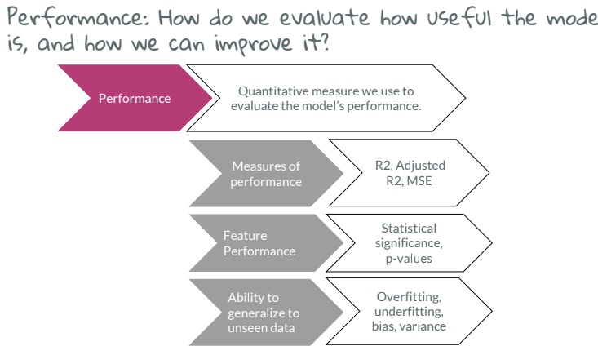
Regression & Model Validation

Slide 13

Practice!

Slide 14
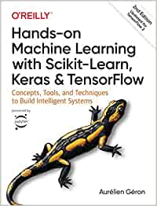


Bibliografía
/1./ /Hands-on Machine Learning with Scikit-Learn, Keras, and TensorFlow/
/2./ /Fast.AI - Introduction to Machine Learning for Coders/
/3./ /MLCourse.AI/
/4./ /DeltaAnalytics/
/5./ /The Hundred-page Machine Learning Book/
/6./ /Machine Learning for Humans (Vishal Maini)/
/7./ /Datacamp/
/8./ /DataQuest/

Slide 15

WI-FI
Wi-Fi
madrid@saturdays.ai

